Slide 1
CUSTOMER CHURN PREDICTION IN TELECOMMUNICATION INDUSTRY
Presented By:
Anusruta Dutta
Saurabh Ranjan
Chinna Ussenaiah

Slide 2
INTRODUCTION
The Telecom sector has become one of the main industries in developed as well as Developing countries.
Technological progress and the increasing number of operators raised the level of competition among Telecom Companies .
Company are working hard to survive in this competitive market depending on multiple strategies.
Telecom customer churning(leaving company Services) is one of the main problems in the industry.

Slide 3
CHALLENGES
Acquire new customers
Attracting new customers is much more expensive.
Upsell the existing customers
Retaining existing ones is one of the major concern.
increase the retention period of customers
Customers starve for better services and prices, while their requirements are extremely complex and difficult to understand for Telecom
Finding the influential factors for the customer churn is very important.

Slide 4

Reasons for Churn
Easy to switch provider
Quality of service
Plenty of attractive offers
Customer dissatisfaction

Slide 5
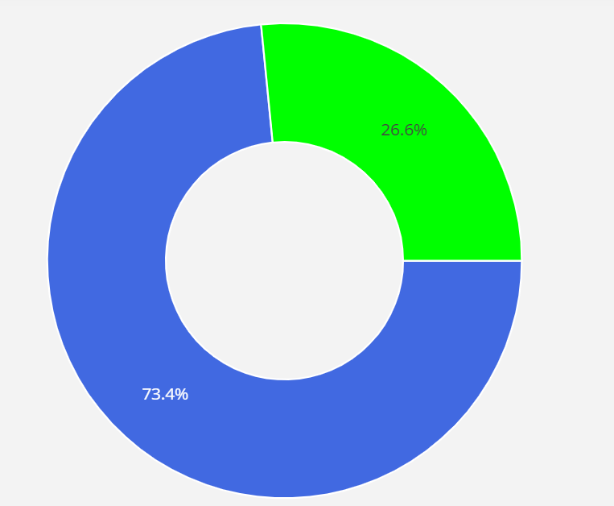

Customer Churn-Not Churn
Total 7043 customer we conducted our experiment and out of which 1873 found to be churning that is 26.6% almost one-fourth
Notes:
Tor

Slide 6
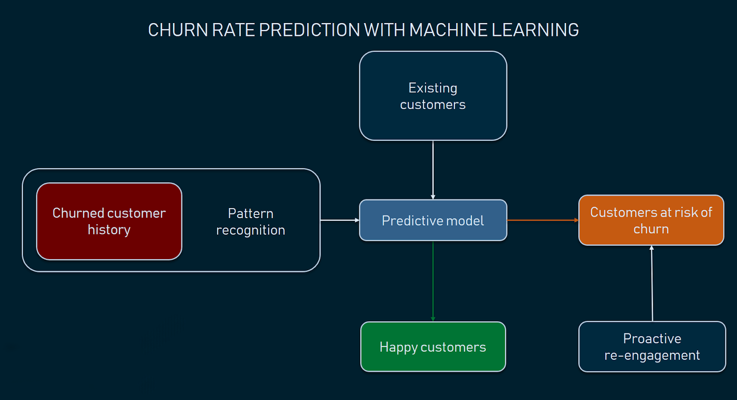

Slide 7
Analysis Methodologies
Models | Accuracy | (AUC) | Recall | Precession | F1 Score
Logistic Regression | 0.81 | 0.72 | 0.54 | 0.67 | 0.58
KNN | 0.80 | 0.72 | 0.55 | 0.65 | 0.58
SVM | 0.81 | 0.71 | 0.51 | 0.68 | 0.58
Decision Tree (gini) | 0.73 | 0.65 | 0.47 | 0.50 | 0.50
Decision Tree (entropy) | 0.74 | 0.66 | 0.49 | 0.52 | 0.49
Random Forest | 0.77 | 0.68 | 0.49 | 0.60 | 0.57
XgBoost | 0.81 | 0.72 | 0.55 | 0.69 | 0.60

Slide 8
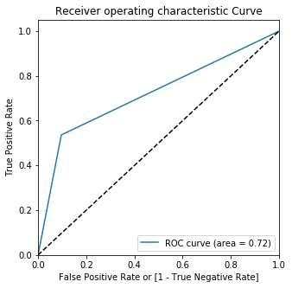
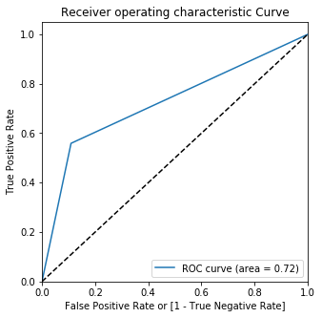
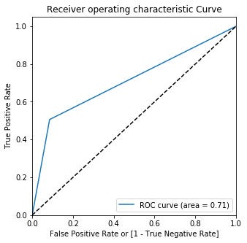
ROC Curves for Various model
Logistic regression
KNN
SVM

Slide 9
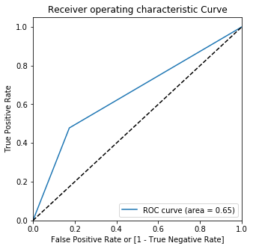
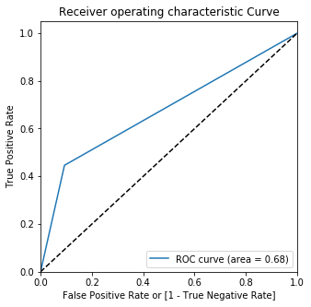
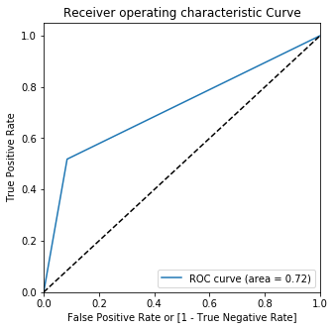
ROC Curves for Various model
Decision Tree (gini)
Random forest
XGboost

Slide 10
Features Effecting by Gini values
Features | Gini Values
Total Charges | 19.423512
tenure | 17.266203
Monthly Charges | 16.774021
Internet Service | 4.351304
Payment Method | 3.871783
Contract | 2.838730
Paperless Billing | 2.624254
Online Backup | 2.268476
Partner | 2.264401
Tech Support | 2.228723

Slide 11
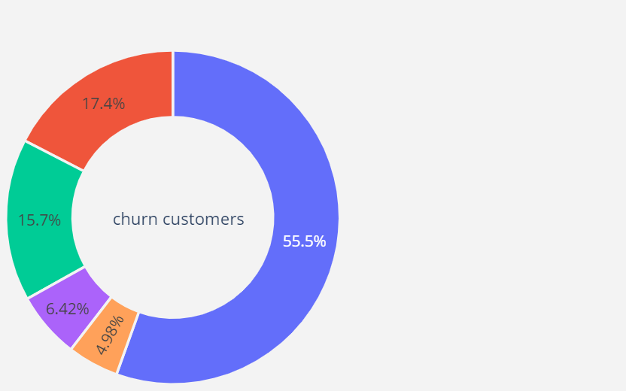
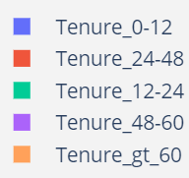
Churn on the basis of Tenure

Slide 12
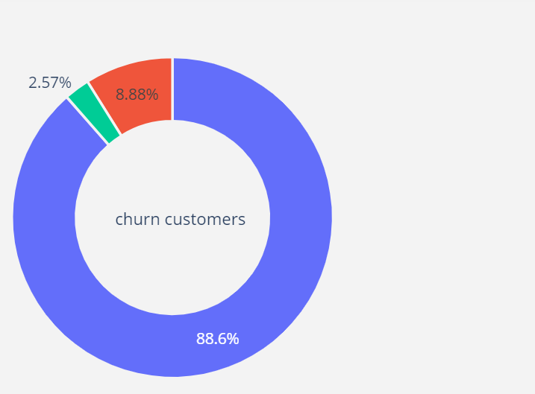
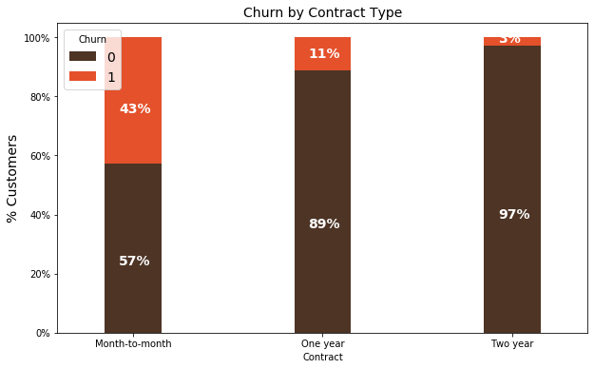
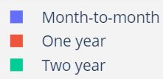
Contract Distribution in customer Data

Slide 13
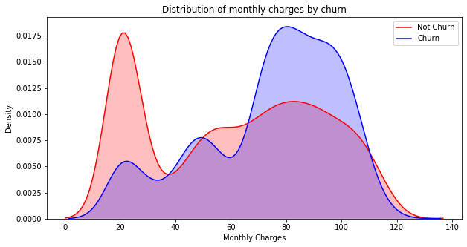
Monthly charges Distribution in customer Data

Slide 14
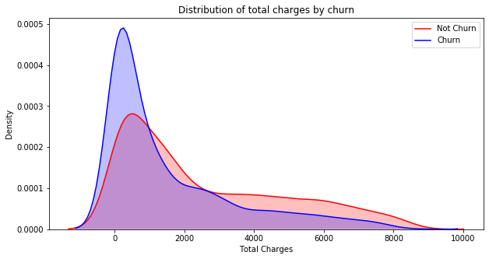
Total charges Distribution in customer Data

Slide 15
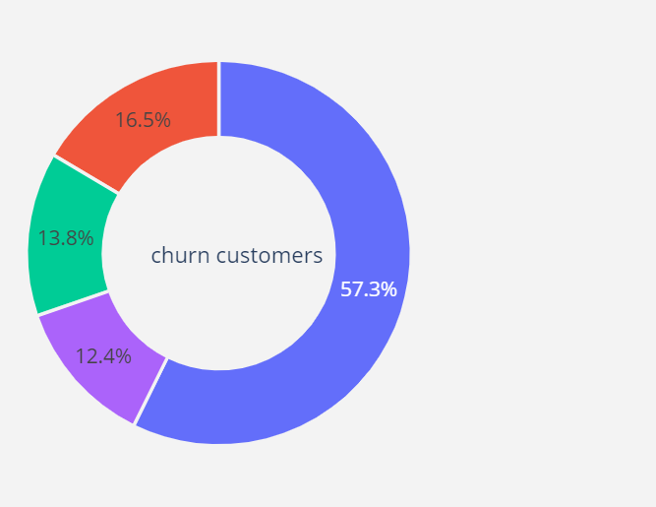
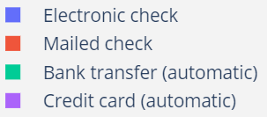
Payment Method Distribution in customer data

Slide 16
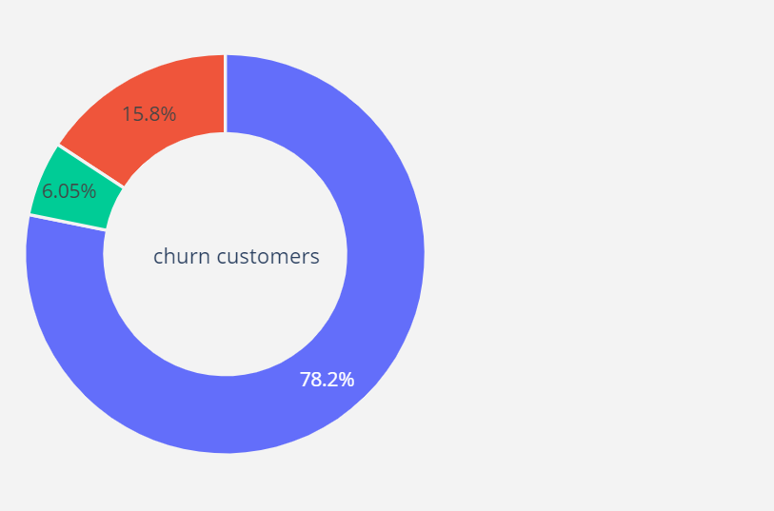
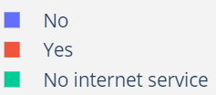
Online Security Distribution in customer data

Slide 17
CONCLUSION
(Tenure)…..If the customers have been with the company for long duration then the customers churning probability is less.
(Contract)…..If the customers taking the longer contact they are more loyal to the company.
(Payment Method)….Electronic check customers are more churning because sometime money is not paid easily via these method and it takes time.
(Online security)…..if company start providing online security with benefits to the customer they will not churn out

Slide 18


